Slide 1
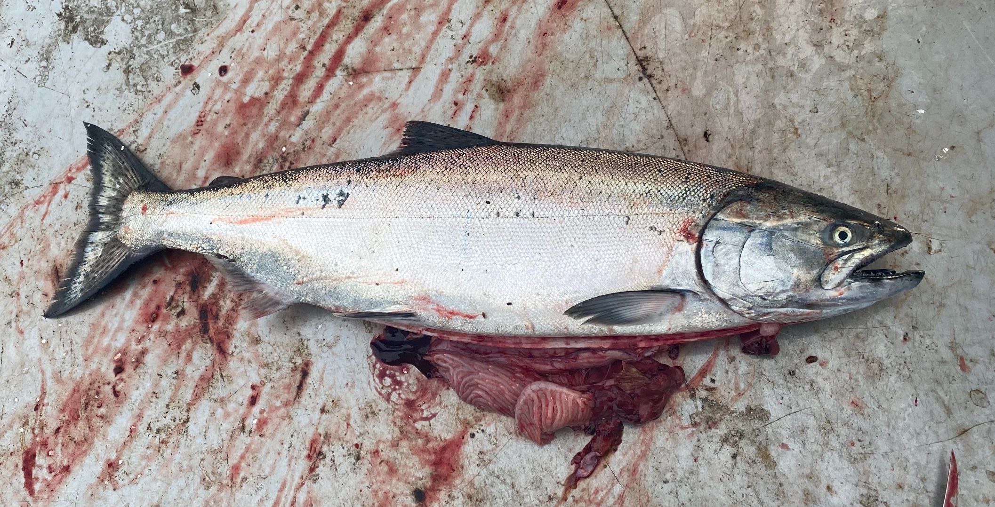


Adult Salmon Diet Program
ES 482/582 Data Project By Rebecca Hansen and Jessica Qualley April 3, 2020
Notes:
We would like to acknowledge Will Duguid, Katie Innes, Micah Qunidazzi, Nick Bohlender, and Francis Juanes for oper

Slide 2
Introduction
Research question
Hypotheses

Slide 3
Description of Data
Data collection
Response variable
Explanatory variables

Slide 4
Description of Data
Plot “key features of dataset” using all data or a subset

Slide 5
Statistical Methods
What kind of model
Why
Probability distribution for response
Random effects and non-independence

Slide 6
Results
Plot “response relative to explanatory with model”

Slide 7
Results
In the context of results and hypotheses

Slide 8
Discussion
Limitations to data analysis approach

Slide 9
Discussion
Results in context of existing knowledge
Future research questions

Slide 10
Checklist
PDF file
10 slides max
2 slides of plots min
Complete sentences

